Slide 1
Viable Cities
Together towards climate neutral and sustainable cities 2030

Slide 2







Viable Cities
Climate neutral cities 2030
– with a good life for all within the planetary boundaries
Over
KLIMATKONTRAKT
member
organisations
from public sector, business, academia and civil society
cities in Sweden
International cooperation
a Swedish Climate City Contract
TOTAL BUDGET
UNTIL 2030
(one hundred million euros)

Slide 3


The mission
Visionary, yet clear and concrete objective
A broad perspective where ecological, economical and social sustainability are equally important
We need to engage and gather many forces, across sectors, actors and disciplines
The Mission:
Climate neutral cities 2030
– with a good life for all within
the planetary boundaries
The climate transition will provide greener, safer cities with better air quality, better mental and physical health, where children and adults can live, play and enjoy life
Olga Kordas

Slide 4

Why cities?
Cities cover about 3% of the land on Earth, and produce about 72% of all global greenhouse gas emissions
Cities are growing fast – by 2050 almost 85% of Europeans will be living in cities

Slide 5

System innovation – as an iceberg
Radical changes in society on many levels
Visible levels: Innovative solutions, partners and networks
Invisible levels: behaviour, governance, policies

Slide 6

A portfolio of initiatives aiming at the mission
We gather strength by moving from fragmented projects to an ecosystem of efforts aiming at a common goal

Slide 7

Climate neutral cities 2030
Together with cities – municipalities and their partners – and government agencies we strive towards the mission: Climate neutral cities 2030
We try new solutions and new ways of working, and learn from each other
Klimatkontrakt 2030 – a Swedish Climate City Contract – is an instrument to speed up the climate transition
The initiative grows – from nine cities to 23

Slide 8

Climate Neutral Cities
Commitments by Mayors: goals, strategies, governance, citzens involment, climate investment plans and funding
Signed by the Mayors, the government agencies and Viable Cities
National support to cities
Policy/
better regulations
More
innovation
Coordinated
funding/financing

Slide 9

Transition Lab – the strategic backbone
Many need to make good decisions to speed up the climate transition: municipalities, companies, authorities and ordinary people
That is why we work together with cities, companies, researchers, politicians, officials, authorities and citizens.
We try our ideas, we fail, we learn and we try again – always with the mission in mind

Slide 10

From Sweden to EU
From the Swedish Climate City Contract 2030
to EU’s mission on 100 climate neutral cities – by and for citizens, and and a European Climate City Contract
2019
9 svenska städer
2021
20 svenska städer
We are inspired by – and inspire
– EU and European cities – as well as global initiatives
2030
100 europeiska städer

Slide 11
Viable Cities and Net Zero Cities
National nodes
for coordination
EU: Europe shall be a climate neutral continent by 2050
A lot of initiatives within Horizon Europe
Net Zero Cities – Climate City Contract
Viable Cities Klimatkontrakt 2030 – the first in Europe
Driving Urban
Transitions
(DUT/JPI Urban Europe)
partnership
Klimatkontrakt 2030
New European Bauhaus
Positive Energy
Districts (PED)
ENUTC
EU Climate City Contract
Net Zero Cities
Pilot call
100 climate
neutral cities

Slide 12



Iteration of the Swedish Climate City Contract 2030
Learnings from the first version signed in December 2020 – key areas where we need more knowledge to speed up the climate transition
How can digitalisation and digital tools contribute to the transition to climate neutral cities?
We need everyone to be involved to succeed, how can we involve the citizens and civil society?
How do we finance all
the investments that we
need to do?

Slide 13

Climate smart mobility
2030
Cities produce over 70 percent of all global greenhouse gas emissions. The emissions derive mainly from the transport of people and of goods
A long-term cooperation with the strategic innovation programme Drive Sweden
A part of Climate City Contact 2030
Aiming at acceleration the transition to climate neutral mobility in cities

Slide 14

Climate City Contract 2030 – sharper each year
Klimatkontrakt 2030:
A long-term commitment from all signing partners
Ensures cooperation between the cities and the government agencies
follow-up and revision each year, both on local and national level

Slide 15
Climate City Contract – until 2030
MISSION
2030:
Climate neutral and sustainable cities
2020
2021
2022
2023
2024
2025
2026
2027
2028
2029
Start
systemdemo
2029
2028
2027
2026
2025
2024
2023
2022
2021
2020
2019

Slide 16

What does the Climate City Contract 2030 say?
The cities undertake to – based on local conditions – collaborate with many in society and work in new ways to reduce climate emissions and work for a sustainable society
The authorities undertake to facilitate the urban transition by coordinating the national level, for example regarding financing and the review of laws and regulations
Viable Cities undertakes to long-term support and coordinate development, revision and analysis of the work with the Climate City Contract 2030

Slide 17
From Sweden to a
European Climate City Contract
National nodes
for coordination
The Swedish Klimatkontrakt 2030 is the first Climate City Contract in Europe, maybe in the whole world
Ambition: To inspire EU:s initiatives regarding climate neutral cities and an European Climate City Contract.
EU’s Green Deal
100 climate neutral cities – by and for citizens
Net Zero Cities
Positive
Energy
Districts
Driving Urban
Transitions
(DUT/JPI Urban Europe)
partnership
Klimatkontrakt 2030
New European Bauhaus
ENUTC
EU Climate City Contract
Net Zero Cities
Pilot call
100 climate
neutral cities

Slide 18

The benefits of the climate transition
Lower greenhouse gas emissions provide a higher quality of life for the people who live, work and stay in the city
Viable Cities strives towards ecological, economic and social sustainability in cities
Financial sustainability - new business opportunities, new jobs
Social sustainability - gender equality, good living environment and health, strengthened welfare
Environmental sustainability – functioning ecosystems, maintaining biological diversity

Slide 19


This is how much emissions must be reduced
Drastic reductions in greenhouse gases are required per year at least
Paris Agreement 2015 global warming
below
Degrees
IPCC:s rapport nr 6
Viable Cities aims for zero emissions by 2030

Slide 20

Climate transition in cities globally
Cities account for most of the emissions
Cities' climate transition is extremely important for all countries
We contribute by collecting and sharing Swedish experiences
We are inspired by listening and learning from the efforts of others
Our ambition is to contribute to a faster climate transition globally

Slide 21
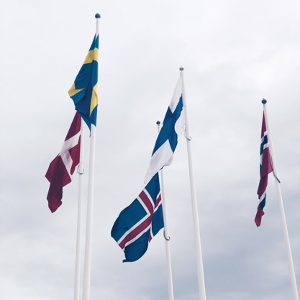
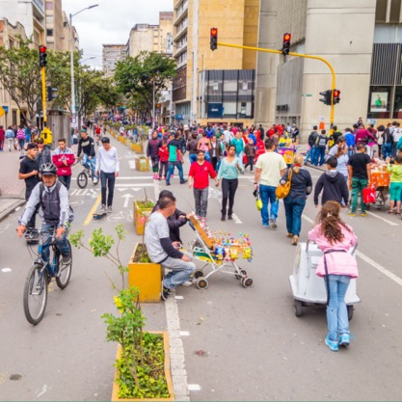
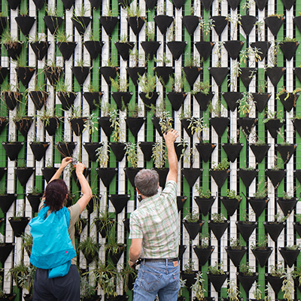
International collaboration
Nordic Transition Partnership is aiming at accelerating the transition to climate neutrality 2030 in small and medium-sized municipalities in the Nordic region
Climate Smart Cities Challenge, is a global innovation competition aimed at solving climate and sustainability challenges in four cities: Curitiba, Bristol, Makyonde and Bogota
DUT - Driving Urban Transition and PED - Positive Energy Districts,
are two European programmes
aiming at 100 energy-positive
districts in the EU by 2025

Slide 22

The cities’ commitments in Klimatkontrakt 2030
So far, nine Swedish cities have signed Klimatkontrakt 2030. In their contracts they have committed to:
drastically reduce climate emissions
increase social and economic sustainability
strengthen the city's ability to collaborate in new, effective ways

Slide 23

The authorities’ commitments
Four government agencies have signed Klimatkontrakt 2030: The Swedish Energy Agency, Vinnova, Formas and the Swedish Agency for Economic and Regional Growth
They have committed to:
review laws and regulations to make it easier for municipalities to take the lead in climate change
create a national platform that makes it easier for municipalities to finance initiatives and invest in climate change

Slide 24

Viable Cities’ committments
The strategic innovation programme has committed to:
facilitate learning between cities
support the processes for changes in rules and policies
facilitate long-term and systematic innovation work
coordinate funding opportunities
support the cities’ applications for EU calls

Slide 25
Storytelling – a tool for climate transition
Everyone in the city needs to be involved in the climate transition. And people do not listen to facts. To create understanding and change behaviors, we need stories that make us feel.
The storytelling project:
Development of a tool for creating local engaging stories about climate transition in cities
Combination of behavioral psychology and storytelling
Pilots in the municipalities of Umeå and Malmö

Slide 26

Main processes
System demonstration
International and EU collaboration
Onboarding 23 cities
Change logic / effect logic
Notes:
Climate City Contrakt 2030 – follow-up, implementation, development in collaboration with cities and governement agencies
System demonstration concept development and call
International and EU initiatives for the mission climate-neutral cities
Change logic / effect logic – follow-up and development of the program's logic
Onboarding cities facilitate the expansion of the programme to 23 cities

Slide 27




Slide 28

Good examples from the cities

Slide 29
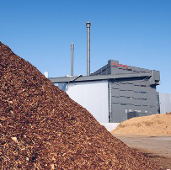
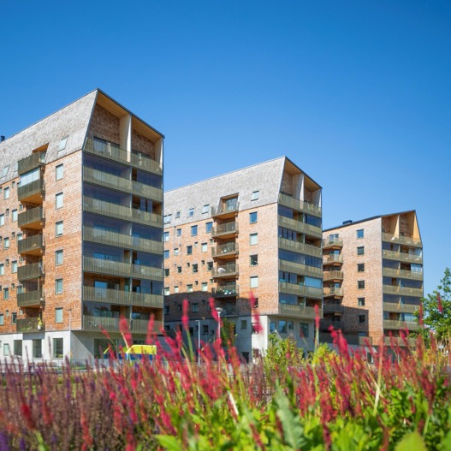
Växjö
Introtext om staden här. Qui corro et volendendis sim nusdam dolo velitatem eos nim. Asimus, qui abo. Ulpa cus si dit ratem enim ducipsum. Abo simus, qui. Ulpa cus si dit ratem enioras upi ducipsum est voro.
Det svenska Klimatkontrakt 2030 är det första i Europa, i världen.
Det svenska Klimatkontrakt 2030 är det första i Europa, i världen.

Slide 30
Viable Cities board

Slide 31


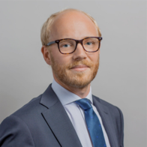


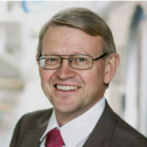
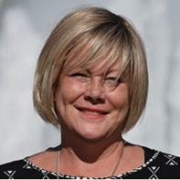
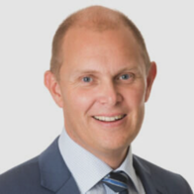


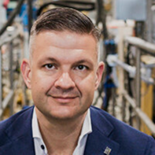
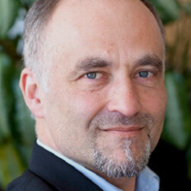

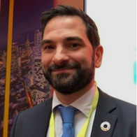
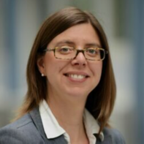
Viable Cities board
Cecilia Schelin Seidegard
President
Anders Wijkman
Vice President
Magnus Thulin
Stockholms city
Mikael Östling
KTH
Anna Ledin
Göteborgs city
Johan Gammelgård
Umeå municipalty
Mikael Anneroth
Ericsson AB
Lena Neij
Lunds University
Marco Lucisano
RISE Research
insitutes of Sweden
Ulf Ceder
Scania CV AB
Rebecka Persson
Malmö city
Jonas Kamleh
Climate-KIC (adjungerad)
Catarina Nauclér
Fortum Sverige

Slide 32
Extras

Slide 33
















Slide 34
TeklaRios as debit, sa consed ma nonse alitaspic totatis imoditatis quia simus eseditatum consequo berferf eratecati voluptu rernature porehentius essus, nonsenda dolesec aborepudit eos quiatur.

Slide 35







Slide 36



Slide 37
Tomma mall-slajds

